Slide 1
Monday, May 8- Thursday, May 11

Slide 2
Marvelous Monday, May 8
Good morning! ☺
Turn in the two paragraphs from Friday if you finished them for HW.
Have your copy of the “I Have a Dream” speech on your desk.
On the back of the speech (or another sheet of paper), write down three things you would like to know about the speech.

Slide 3
Objective
You will compare and contrast listening to a speech and reading a speech.

Slide 4
Agenda
Good things ☺
Social Contract Review
“I Have a Dream”
Kahoot Activity
Video
Video Questions
Multiple choice questions (finish for HW tonight)

Slide 5
Social Contract Review
- The class will focus on __________ this week.
- I will write the letters on the board. Each letter is worth 2 minutes of “free time” at the end of class. When a classmate is not following the social contract, I will erase a letter.

Slide 6
“I Have a Dream” Kahoot Activity

Slide 7
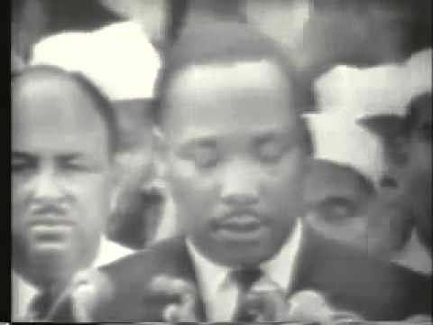
“I Have a Dream” Video

Slide 8
“I Have a Dream” Video Questions
Complete the “I Have a Dream” video questions.
Turn in your completed “I Have a Dream” questions.
Pick up “I Have a Dream” multiple choice questions.
Finish “I Have a Dream” multiple choice questions for HW if not completed in class. **Keep this activity if you complete it in class.**
Read or work on other work.

Slide 9
Terrific Tuesday, May 9
Good morning! ☺
Have your HW on your desk.
On the back of the speech, write what Dr. Martin Luther King, Jr. means when he says “dream” in his speech.

Slide 10
Objective
You will use figurative language to create your own version of a text.

Slide 11
Agenda
Good things
Review “I Have a Dream” Multiple Choice Questions
I Have a Dream, Too!
Brainstorming
Rough Draft (**finish for HW if not completed in class**)

Slide 12
“I Have a Dream” Multiple Choice Questions
B
D
A
B
B
D
C
B
B
B
D
B
C
A
A
D
D

Slide 13
I Have a Dream, Too!
Brainstorming Sheet
Rough Draft (finish for HW if not completed in class)

Slide 14
Wonderful Wednesday, May 10
Good morning! ☺
Have your rough draft on your desk.
Check your rough draft for correct spelling and punctuation.
Check your rough draft to make sure it includes all the figurative language mentioned in the rubric.

Slide 15
Objective
You will use figurative language to create your own version of a text.

Slide 16
Agenda
Good things
I Have a Dream, Too!
Final Drafts

