Slide 1
Wonderful Wednesday, Feb. 1
Read for 10 minutes.

Slide 2
Good Things!

Slide 3
Happy February!
Black History Month

Slide 4
Objectives
By the end of the class, you will be able to thoroughly annotate a text.
By the end of the class, you will be able to use a nonfiction text to identify the 3 most important facts about a prominent person.
By the end of the class, you will be able to use a nonfiction text to identify 1 word that best describes a prominent person.

Slide 5
Thoroughly annotate your nonfiction text.
Questions
Connections
Summaries
10 minutes

Slide 6
Five Facts
With your group, write the five most important facts about the person from this nonfiction text.
JOBS:
GROUP REPRESENTATIVE- will share your group’s facts with the class
RECORDER- will write your group’s facts on the paper I give you
TRACKER- make sure everyone in your group is on task
TIME KEEPER- remind group members of how much time is left
FACILITATOR- moderates group discussion

Slide 7
Time to share!

Slide 8
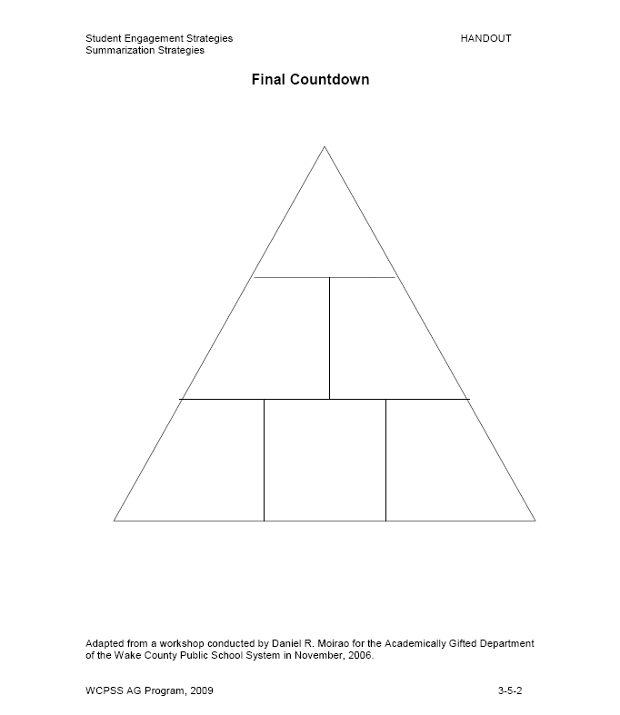
Final Countdown

Slide 9
Final Countdown
Top → 1 word that BEST describes the person
Middle → 2 questions you have about that person
Bottom → 3 MOST IMPORTANT facts about that person

Slide 10
Objectives
By the end of the class, you will be able to thoroughly annotate a text.
By the end of the class, you will be able to use a nonfiction text to identify the 3 most important facts about a prominent person.
By the end of the class, you will be able to use a nonfiction text to identify 1 word that best describes a prominent person.

